Slide 1




PROJECT – III WORD PUZZLE
CME1252 Project Based Learnıng-II
by:
2018510016 Sadullah Cihan
2018510086 Zeynep Öztürk
2019510103 Enes NİYAZİ Baltacı
May, 2020
İZMİR
Notes:
Hello everyone. I’m Zeynep.
(herkes adını söyler)
We’re gonna present our project
that name is WORD PUZZLE

Slide 2
OUTLINE
Code
Sleep
Eat
INTRODUCTION
PROGRESS SUMMARY
Requirements
Task Sharing, Scheduling
Completed Tasks
Additional Improvements
Problems Encountered
ALGORITHMS AND SOLUTION STRATEGIES
SCREENSHOTS
CONCLUSION, REFERENCES
Notes:
This is our outline. We’re gonna follow these titles.

Slide 3


INTRODUCTION
WHAT IS THE WORD PUZZLE GAME ?
Two-player game.
Played on a 15x15 puzzle screen
Get the highest score and be the best player.
Notes:
Word puzzle is a two player game.
The aim of the program is to develop a two-player game about guessing specific words correctly in the puzzle table.
Also,A player can guess the Turkish meaning of the completed word. Now, Enes will continue with progress summary.

Slide 4




PROGRESS SUMMARY Requirements
Eclipse
Trello
Canva
Single Linked List (SLL)
Multi Linked List (MLL)
Double Linked List (DLL)
Enigma Library
Notes:
We used eclipse as compiler. Trello for communication. Also Canva for poster. SLL,MLL,DLL data structures have been used… and enigma library.

Slide 5



PROGRESS SUMMARY Task Sharing
Enes Baltacı Sadullah Cihan Zeynep Öztürk
*Designing of classes. *Designing of classes. *Designing of classes.
*Designing the screen. *Reading files. *Reading files.
* Designing SLL and MLL. *Designing the screen. * Designing SLL and MLL.
*Letters and word controls. *Designing SLL and MLL. *High score table.
*Letters and word controls. *Letters and word controls.
*Score calculation.
*Writing to the text file.
Notes:
At the beginning of the project, we have started personally. Then, we made plan and apportioned/divided the project missions. And we accomplished these sub-titles.

Slide 6
PROGRESS SUMMARY Scheduling
1st week: Discussing and designing solution alternatives. Design of classes.
2nd week: Reading word files. Designing the screen. Cursor movement. Implementation of SLL and MLL.
3rd week: Letters and word controls on MLL. Score calculation and designing Double Linked List.
4th week: Implementation High-score table and error controls and remaining parts of the project.
Notes:
First week we disgussed the algoritm design of the project. Second week word files have been read and SLL MLL classes have been designed.
Third week, letter controls have been implemented by using MLL.
Last week, DLL has been implemented to sort new high-score table.
Now, Sadullah will continue with completed task.

Slide 7
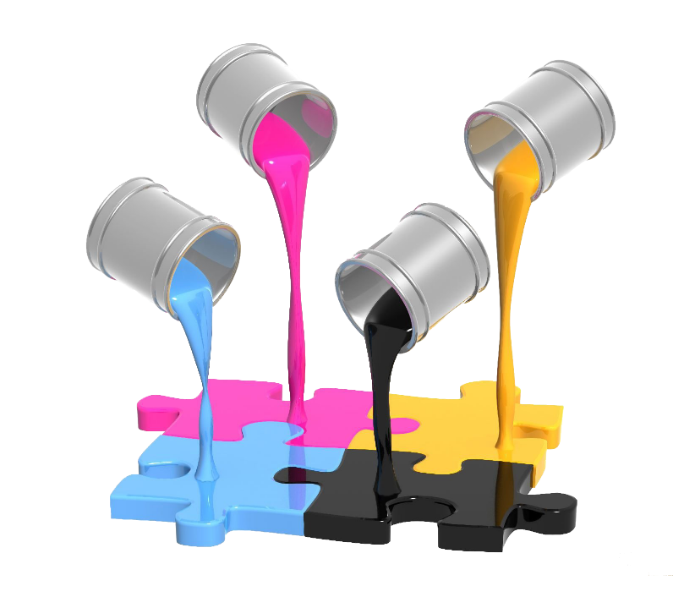
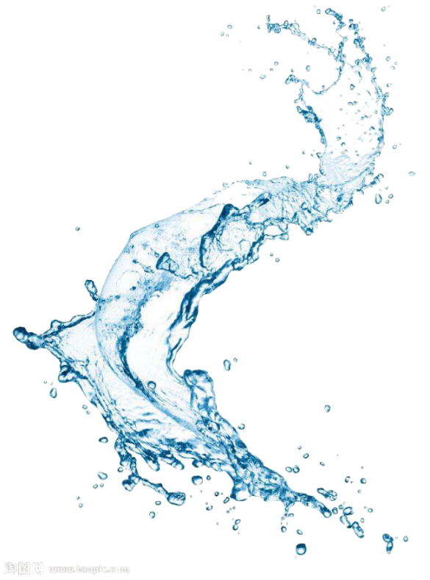

PROGRESS SUMMARY Completed Tasks
Reading necessary files
Cursor Movement
Letter controls on MLL
Score calculation
High-score table by using DLL
Notes:
Completed tasks. Necessary files have been read. Letter control function has been implemented by using MLL. High-score table has been ordered by using DLL.Also, There is no incomplete task.

Slide 8


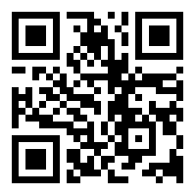
PROGRESS SUMMARY Additional Improvements
createSolutionSLL() method
writeToFile(String path, String newTxtContent) method
You can find the function here
Notes:
Additionally, createSolutionSLL() method and writeToFile method have been implemented. In the createSolutionSLL() method , solution SLL has been created from solution array to check completed word’s correction more easy. In the writeToFile method , new high-score table is written to the txt file. You may see the implementation of writeToFile method with this QR code. Now, Enes will continue with problems encountered.

Slide 9


PROGRESS SUMMARY Problems Encountered
UTF-8 convertion
Array bounds exceptions
Notes:
The first problem that we encountered is UTF eight convertion for Turkish letters; however, while txt file are reading, we converted the taken txt files to UTF eight.
We got a lot of Array bounds exceptions in letterControls() method.This problem has been solved by using boundary control if blocks.

Slide 10


ALGORITHMS AND SOLUTION STRATEGIES
FUNCTIONS WE HAVE USED
printScreen()
readFile(String str)
thePuzzleGame(Player p)
letterControls(Player p)
turkishMeaning(String answerENG, Player p)
highScoreTable()
searchWord()
Notes:
FUNCTIONS WE HAVE USED are these; however, we are gonna talk about the algorithm of thePuzzleGame, letterControls, turkishMeaning, and highScoreTable().
thePuzzleGame(Player p) function contains cursor movement.
In letterControls(Player p) function, when user pressed a key, the correction of the letter and location have been detected.
In turkishMeaning function, user is asked the Turkish meaning of the completed word.

Slide 11
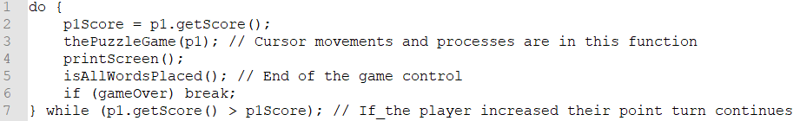
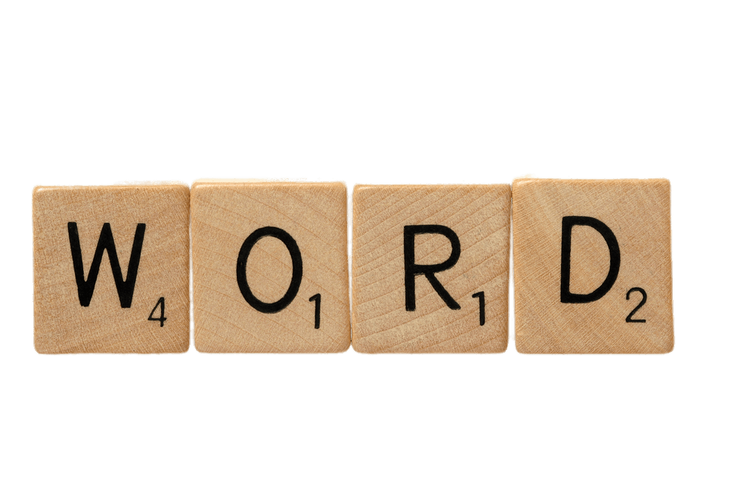
ALGORITHMS AND SOLUTION STRATEGIES General Game Process
Player
Turn
Notes:
Now,I’m gonna talk about general game process. I will simplfy it. This is for turn of both players. The Puzzle Game function basicaly contains cursor movements and direction to letter controls function. After these process, IF the player increased their point the turn continues until wrong letter pressed. Now I give some details of the puzzle game method.

Slide 12


ALGORITHMS AND SOLUTION STRATEGIES
thePuzzleGame(Player p) Method
Cursor movement
Orientation to letterControls(Player p) method
Notes:
If user pressed a key that in the interval of sixty-five*ninety ascii chars, these numbers represents the alphabet, and also the location is empty, Then pressed key is added to puzzle matrix and letterControl funciton is started according to the player.

Slide 13

ALGORITHMS AND SOLUTION STRATEGIES
letterControls(Player p) Method
Word is taken as two patterns
Intersection, vertical or horizontal?
Player gets 1 point
Is the word completed?
turkishMeaning function
Notes:
Firstly, Word is taken as two patterns, vertical, and horizontal>>Letter is controlled whether it’s in the correct location and correct letter, from MLL >>If so, player gets one point.>>While the function is working, word pattern must be controlled if it’s completed or not.>>If so, player gets ten points.>> And the word is sent to turkish Meaning function. Now, Zeynep will continue

Slide 14



ALGORITHMS AND SOLUTION STRATEGIES
turkishMeaning(String answerENG, Player p) Method
Notes:
In the turkishMeaning function we have two paramaters; completed word and current player.
Firstly, two turkish words are assigned randomly. Then correct answer is placed to a,b or c option randomly.
If the user knows correct option, gets ten point. And known word is deleted from MLL.

Slide 15
ALGORITHMS AND SOLUTION STRATEGIES
highScoreTable(Player p)
Adding player between DLL
Printing players on the DLL
Keeping new player as a string
Writing the new player to the file
Notes:
Current player has been added proper order on the DLL. Then top ten players have been printed. The player has been kept as a String. Finally, the player has been writen to the txt file.

Slide 16

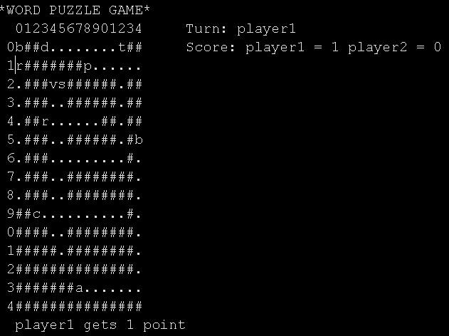
SCREENSHOTS
The Image of Word Puzzle
Notes:
As you can see, in this picture player one gueses the letter R correctly and gets one point.

Slide 17

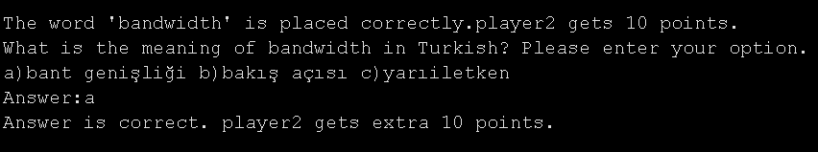
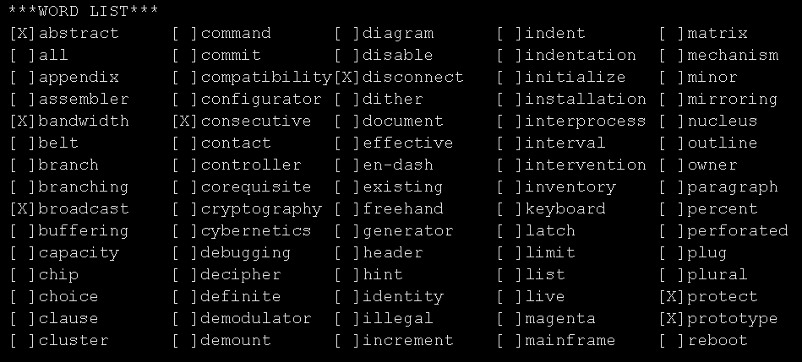
SCREENSHOTS
Notes:
Here, winner has been printed to top of the high-score table. And high-score table has been written to the txt file.

Slide 18
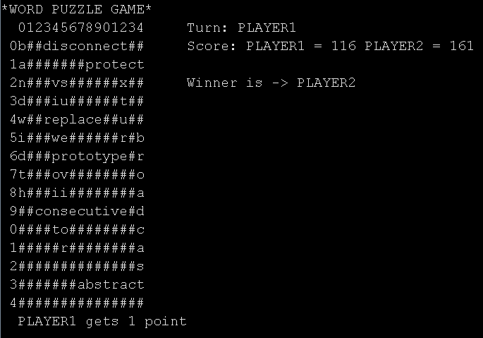
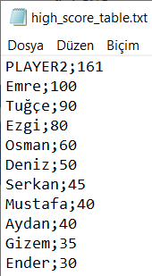
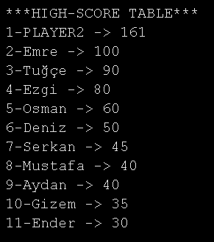
SCREENSHOTS
Notes:
Here, winner has been printed to top of the high-score table. And high-score table has been written to the txt file.

Slide 19



IN CONCLUSION
We have learned:
Effective usage of SLL ,DLL, MLL
Usage of enigma
Working under tough condition
Notes:
-So, WHAT WE HAVE LEARNED in this project?? … We have learned Effective usage of the SLL ,DLL ,MLL data structures and usage of enigma. Also, we have learned to work online a little bit more . It was like hard at the beginning. But, we have got used to doing it. >>I can honourably say that The project has been accomplished on time, exactly and successfully.

Slide 20

REFERENCES
Java Read Write UTF-8 Encoded Data, Lokesh Gupta,
Retrieved 1 May 2020 from
https://howtodoinjava.com/java/io/how-to-read-write-utf-8-encoded-data-in-java/
7-bit ASCII Character Codes, Unknown,
Retrieved 1 May 2020 from
https://www.sciencebuddies.org/science-fair-projects/references/ascii-table
https://www.canva.com [Poster]
Notes:
These are our references. UTF eight , ASCII table and canva for poster.

Slide 21
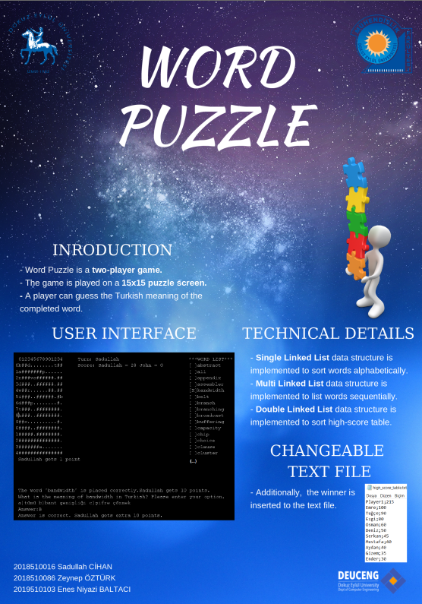
Notes:
This is our poster. I will show detaily.

Slide 22

THANK YOU FOR LISTENING
ANY QUESTIONS?
Notes:
If you have any question, you can ask all of us. Thanks for listening.

